Slide 1
CSE470: Software Engineering
MVC Architecture

Slide 2
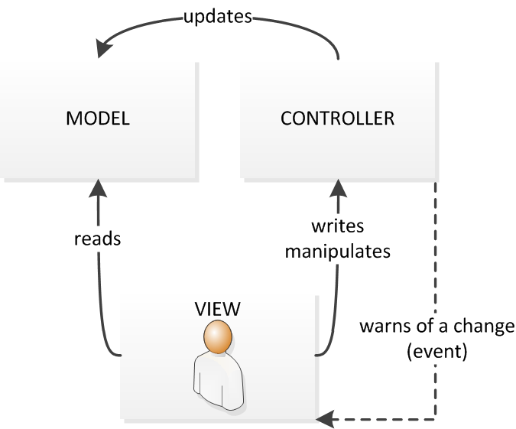
What is MVC Architecture
MVC goes for Model-View-Controller Pattern
Separates presentation and interaction from the data handling logic.
It provides an extensible separation of concern (SOC) from presentation view to data processing logic.

Slide 3
Controller
Handles all the user inputs through url
The interaction to an application starts here by the user interactions – mouse click, key press etc
Process http url requests (GET, POST, PUT, DELETE)
GET: for getting a data
POST: for posting / inserting a data
PUT: for updating a data
DELETE: for removing a data
Communicates with both Model and View
Contains all server side logic
In the example – ProductController, UserController, AccountController etc.

Slide 4
Model
It refers to the Data Related Logic
Interaction with database (such as SELECT, INSERT, UPDATE, DELETE)
It communicates with the controllers
Can sometimes update or collaborate with the view (Depends on framework)
In the example – Product, User, Transaction, Cart etc are model classes.

Slide 5
View
What the end users see (UI)
Usually Consists of html/css
Communicates with the controller
While coding are passed as dynamic values from the controller
A controller can have multiple associated views.
In the example – product.html, user.html to view a html file

Slide 6

MVC Steps
Model
View
[4] Get Presentation of the product data
[2] Get the product data from DB
[5] Returns the presentation with dynamic rendering
[3] Fetch the data and return to controller
[1] Request: Get a product
Controller
Routes
[6] Returns the response

Slide 7
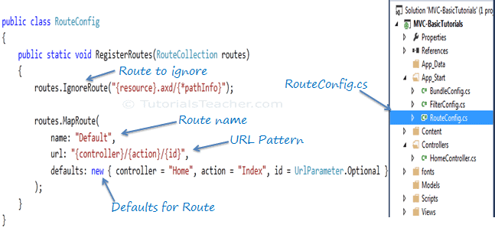
Routes
Are urls to access a resource kept under App_Start folder
General structure - http://domainName/{controller}/{action}/{id}
http://YourApp.com/Users/Profile/25

Slide 8
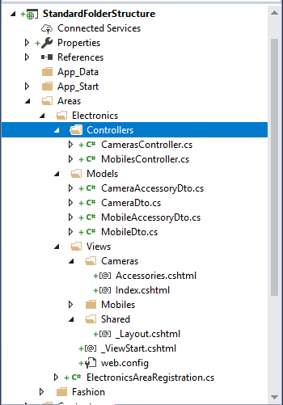
MVC Folder Structure

Slide 9
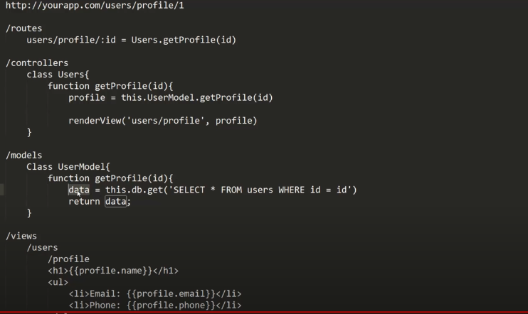
MVC Code Structure

Slide 10
When to use MVC
Used when there are multiple ways to view and interact with data. Also used when the future requirements for interaction and presentation of data are unknown.
Note: Your final project MUST follow MVC Architecture

Slide 11
Advantages-Disadvantages
Advantages:
Allows the data to change independently of its representation and vice versa. Supports presentation of the same data in different ways with changes made in one representation shown in all of them. Other advantages are: parallel working, improved testability, code reusability
Disadvantages:
Can involve additional code and code complexity when the data model and interactions are simple.
JavaScript-based MVC Web App: Click here

